Slide 1

Deep learning Unpacking Transformers, LLMs and image generation
Session 1

Slide 2





About us: Olivier Koch
VP of AI at Onfido
ex-Criteo (2015-2020)
MIT DARPA Urban Challenge Finalist
ENSTA 2002, MIT PhD 2010 (computer vision)
Published @ CVPR 2007, IJFR 2008, ICCV 2009, ICRA 2010
oakfr
@olivkoch
olivierkoch.net

Slide 3
About us: Remi Verronneau

Slide 4
Agenda for today
What you will learn
Organization / setup
A brief history of deep learning
Practical #1: a first neural network

Slide 5
What you will learn
Concepts and practical aspects of deep learning
Build your own backprop, mini-gpt and diffusion models
This course is not a complete overview of all ML & deep learning techniques.

Slide 6
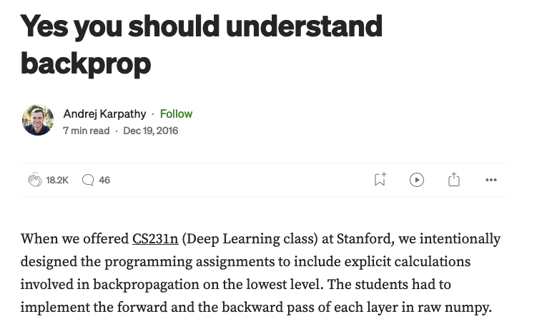
Why learning from scratch matters
You only understand it if you build it
Backprop is a « leaky abstraction »
Source

Slide 7
Organization / Setup
6 sessions
1.5h theory + 1.5h practice
Grading: 6 notebooks (66%) + 1 quiz (33%)
I expect you to return your notebook at the end of each session.
You can then send an updated version over the following week to aim for a better grade (and learn more).

Slide 8
Rules of engagement
It’s OK to ask for help and share tips (use slack)
Each notebook should be yours
You must return your notebook as-is at the end of each TP (via slack)
You can then send an updated version within a week
Please do not use email except for emergencies

Slide 9
References
The theory:
Understanding Deep Learning, Simon Prince, December 2023
Deep Learning: Foundations and Concepts, Christopher and Hugh Bishop, 2023
The Practice:
Neural networks: Zero to Hero, Andrej Karpathy, Youtube Lecture Series, 2022
Deep Learning Course, François Fleuret, 2018-2022

Slide 10
Historical perspective
Neural networks 101

Slide 11
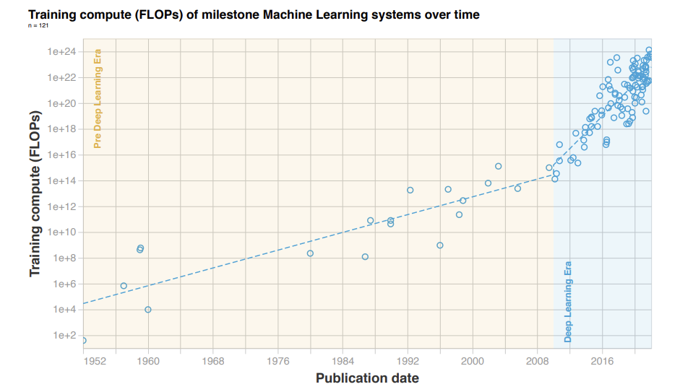
Source

Slide 12
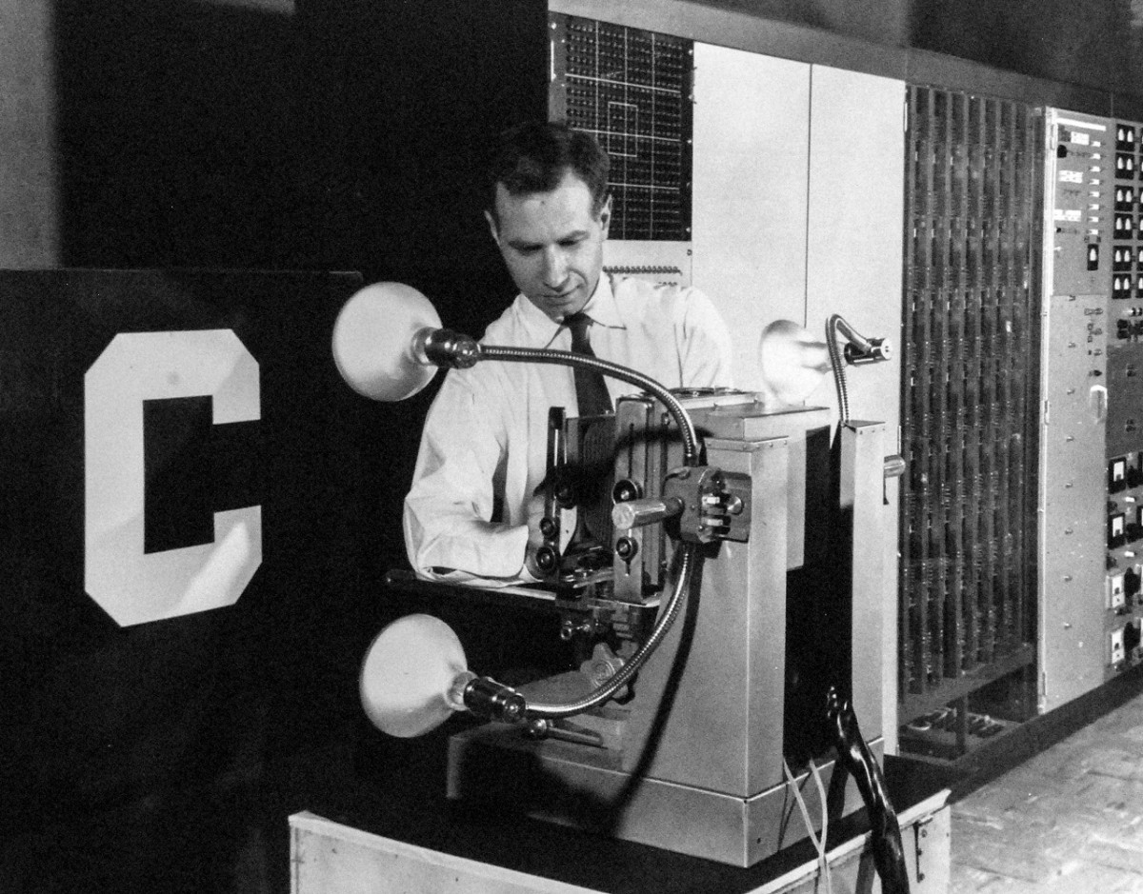
1958
The Perceptron

Slide 13
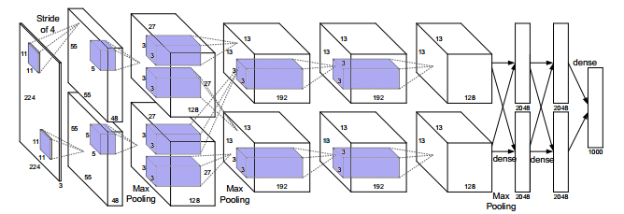
2012
AlexNet

Slide 14
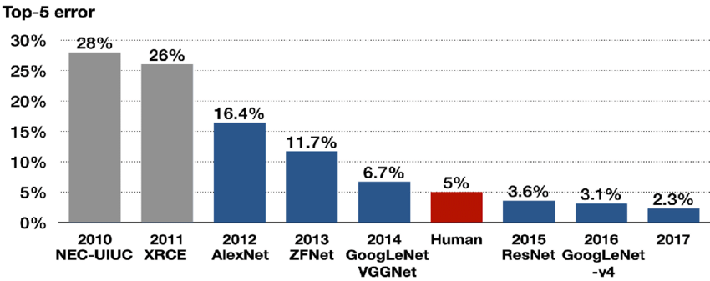
2012
AlexNet

Slide 15
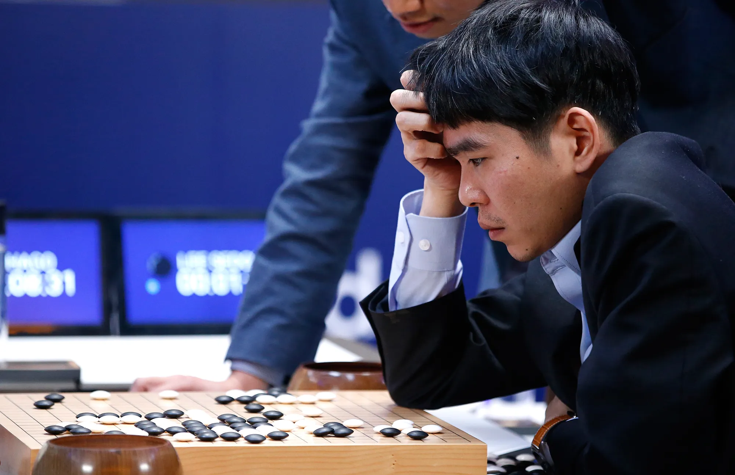
2016
AlphaGo
Reinforcement
Learning (RL)

Slide 16

2017
Transformers

Slide 17

2023
GPT

Slide 18
The Transformer shake-up

Slide 19
What is a Transformer?

Slide 20
No, seriously… what is a Transformer?
We’ll spend a lot of time on this during the course.

Slide 21
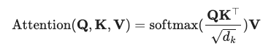
Attention is a communication mechanism between tokens in a document, with a positional embedding allowing to incorporate ordering into sets of tokens.

Slide 22


Transformers shake up translation
Abraham Lincoln (February 12, 1809 – April 15, 1865) was an American lawyer, politician and statesman who served as the 16th president of the United States from 1861 until his assassination in 1865. Lincoln led the Union through the American Civil War to defend the nation as a constitutional union and succeeded in abolishing slavery,...
Abraham Lincoln (12. Februar 1809 – 15. April 1865) war ein amerikanischer Anwalt, Politiker und Staatsmann, der von 1861 bis zu seiner Ermordung im Jahr 1865 als 16. Präsident der Vereinigten Staaten diente. Lincoln führte die Union durch den Amerikanischen Bürgerkrieg, um die Nation als verfassungsmäßige Union zu verteidigen, und war erfolgreich bei der Abschaffung der Sklaverei.
Source

Slide 23
Abraham Lincoln (February 12, 1809 – April 15, 1865) was an American lawyer, politician and statesman who served as the 16th president of the United States from 1861 until his assassination in 1865. Lincoln led the Union through the American Civil War to defend the nation as a constitutional union and succeeded in abolishing ___________,...
Likelihood of “slavery”: 99.2%
Likelihood of “making”: 0.1%
Likelihood of “food”: 3%

Slide 24
Abraham Lincoln (February 12, 1809 – April 15, 1865) was an American lawyer, politician and statesman who served as the 16th president of the United States from 1861 until his assassination in 1865. Lincoln led the Union through the American Civil War to defend the nation as a constitutional union and succeeded in abolishing ___________,...
Context length
Likelihood of “slavery”: 99.2%
Likelihood of “making”: 0.1%
Likelihood of “food”: 3%

Slide 25
Transformers for text generation
Corpus of documents
GPT
Generative Pre-trained Transformer
Text
generator
Language models are few-shot learners

Slide 26
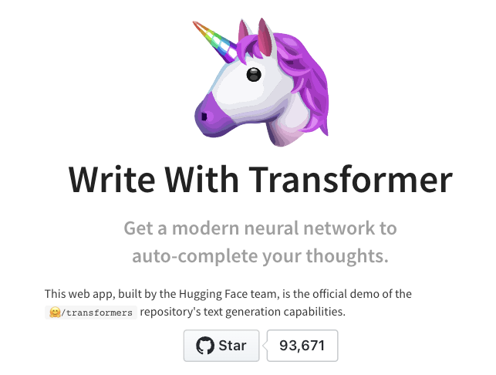
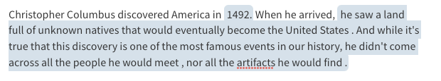
Try it yourself!
https://transformer.huggingface.co/

Slide 27
OK, this is cool, but it hallucinates 100%.

Slide 28
The ChatGPT epiphany
But we know how to train a machine to learn from feedback!
It is called Reinforcement Learning (RL).
Go World Champion Lee Sedol looking confused at move 37 by AlphaGo…

Slide 29
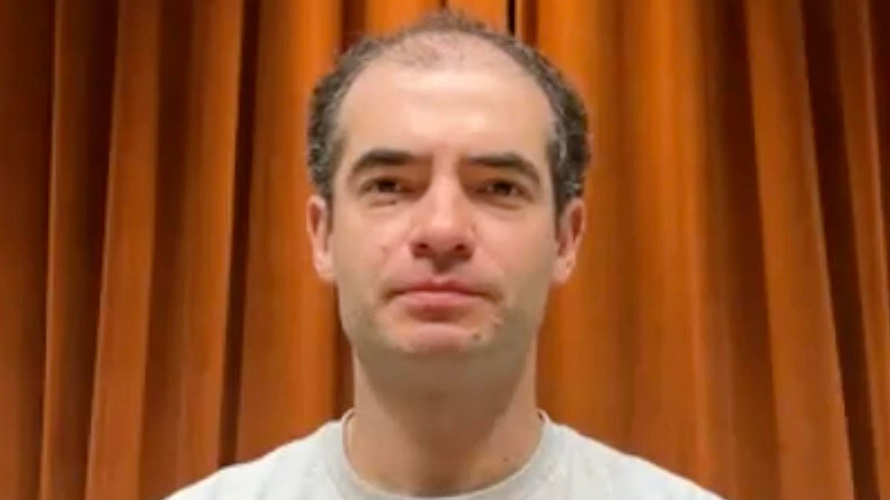
The ChatGPT epiphany
“This whole thing was just an experiment. We had no idea it would work so well”, Ilya Sutskever
(full interview)

Slide 30
The main breakthrough of LLM is the discovery that training a very large model on the simplest task (predict the next token) could yield remarkable apparent intelligence.

Slide 31

Human analysts
Public API
RLHF
Reinforcement Learning from Human Feedback
Magic
model
Corpus of documents
GPT
Generative Pre-trained Transformer
Text
generator

Slide 32
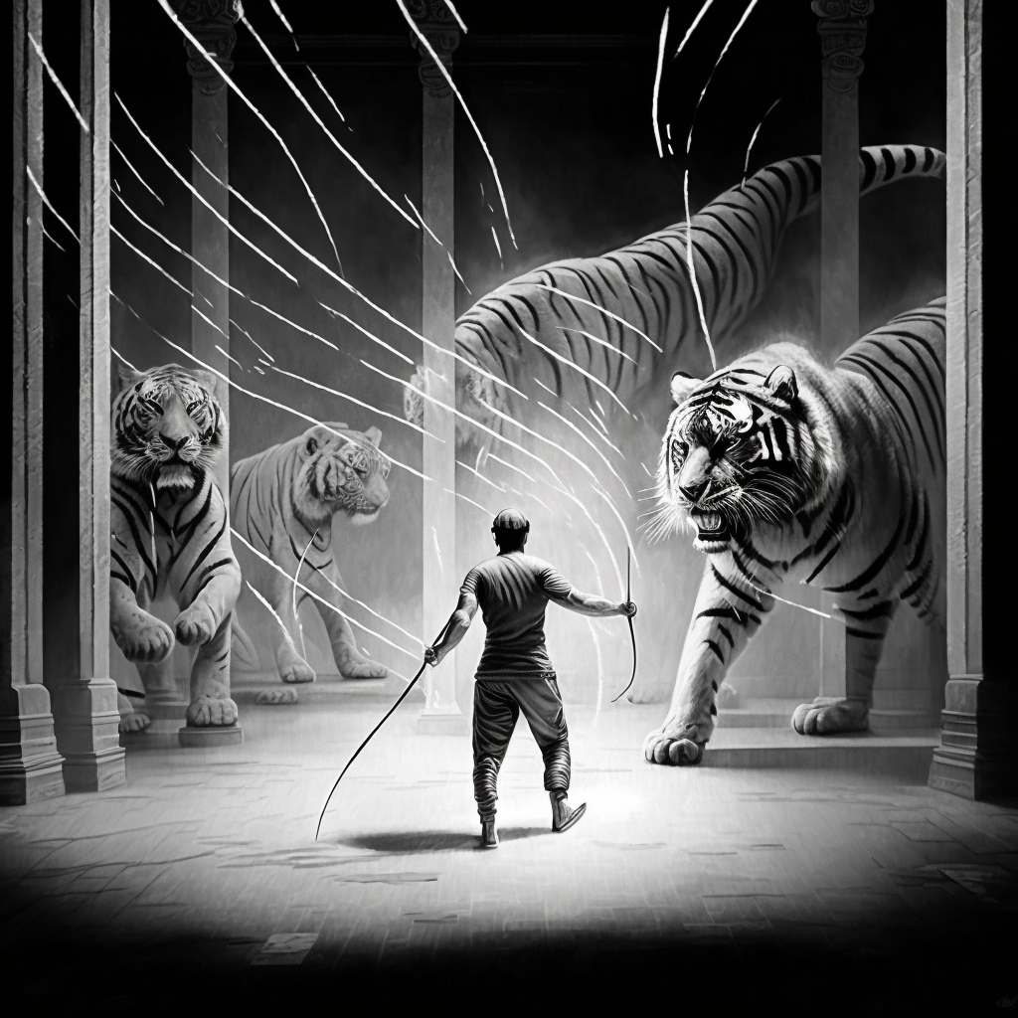
GPT
RLHF
Midjourney
“Man hoarding tigers with a whip, black and white drawing”

Slide 33
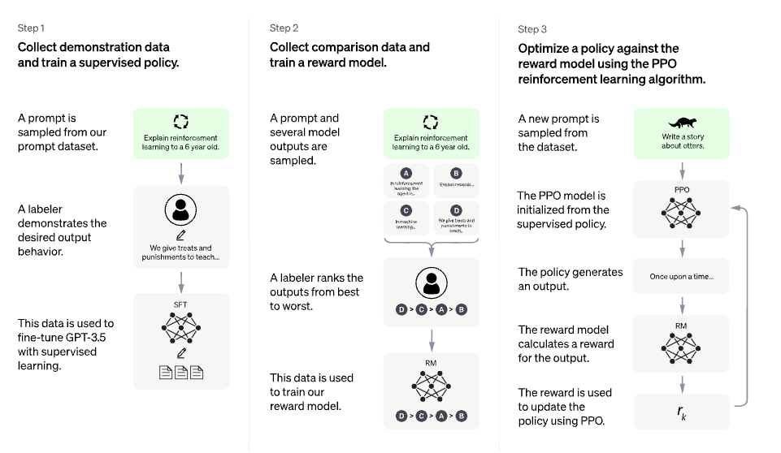
The science of human feedback (alignment)
Source

Slide 34
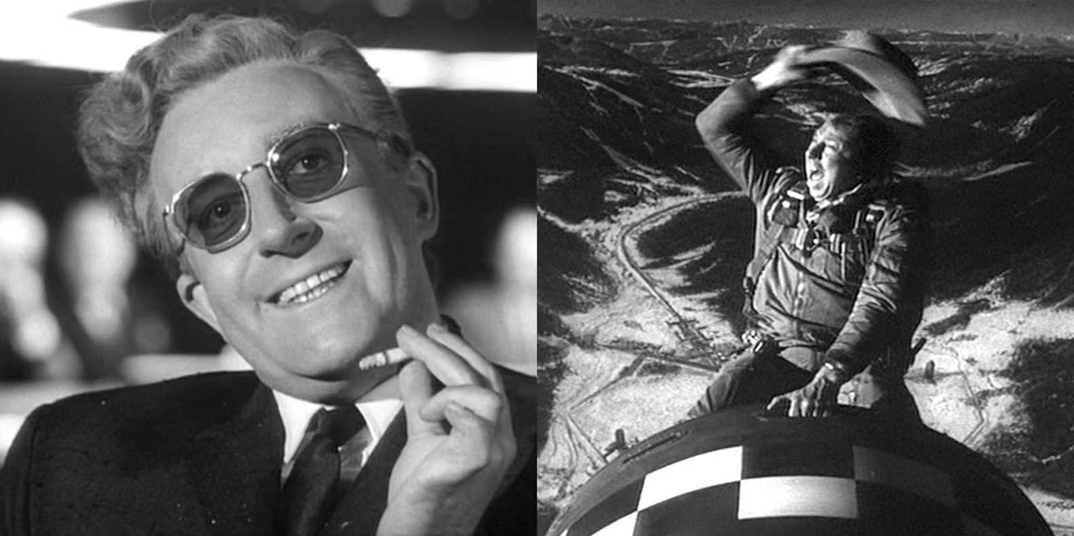
Current state of AI
Frontier: what GPT cannot do today
More predictive power:
Much longer context length
Reliability:
Uncertainty estimation (know when you don't know)
Guardrails (follow instructions of the user)

Slide 35


The Cambrian explosion of foundational models

Slide 36
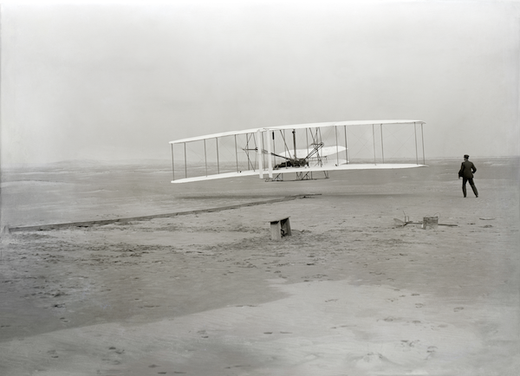
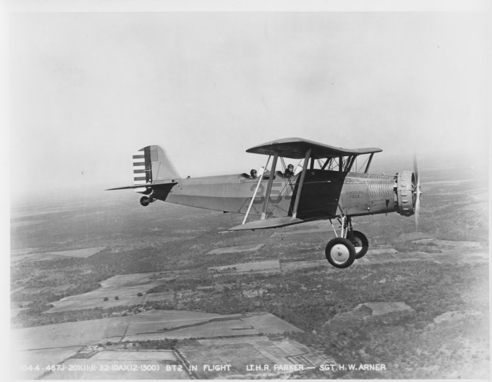
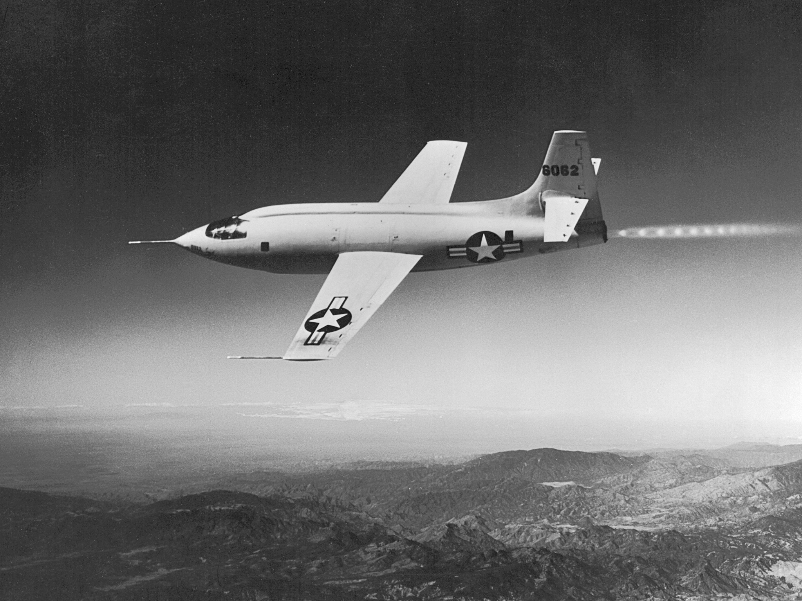
Experimentation is getting much easier
2010
Write your own backprop manually
2018
loss.backward()
2023
from transformers import SwinModel

Slide 37
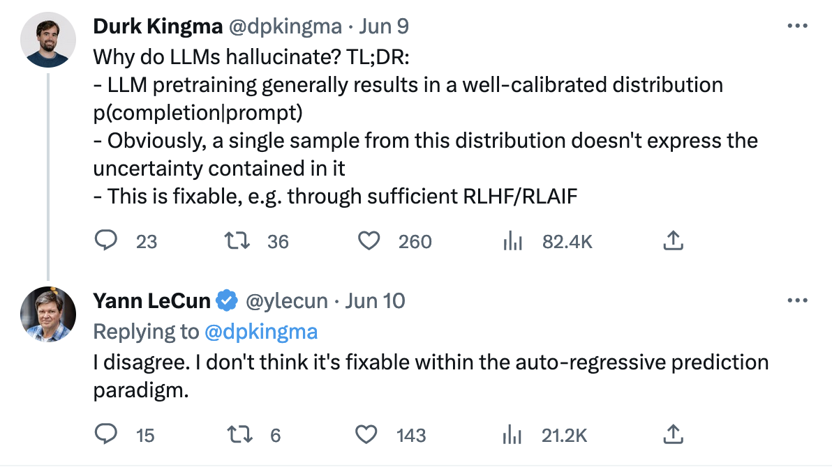
… but research is far from over

Slide 38
Historical perspective
Shallow networks, deep networks

Slide 40
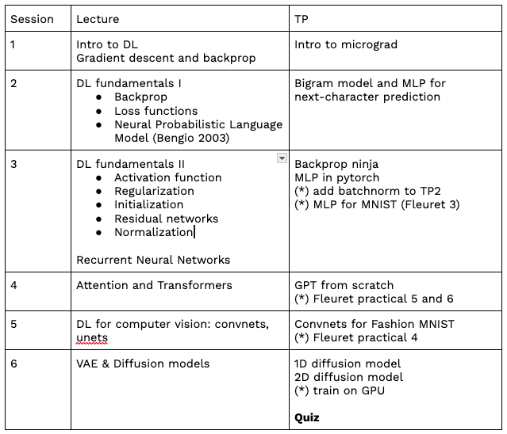
Syllabus

Slide 41
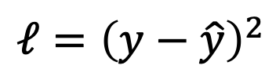
Backprop and gradient descent
𝑥
f_{ω}
𝑦
$$𝓁={\left(y−\hat{y}\right)}^{2}$$
ground-truth

Slide 42
Backprop and gradient descent
𝑥
f_{ω}
𝓁
Goal: find ω that minimizes:
𝓁 = f_{ω}(𝑥)

Slide 43
Backprop and gradient descent
𝓁 = f_{ω}(𝑥)
Assuming f_{ω}(𝑥) is smooth and differentiable w.r.t ω
ω = ω₀
Repeat:
Compute 𝓁(𝑥)
Compute ∇ f_{ω}
ω = ω - η * ∇ f_{ω}
η: learning rate

Slide 44
Backprop and gradient descent
f_{ω}
𝑥
𝓁
ω_{i}

Slide 45
Backprop and gradient descent
f_{ω}
𝑥
𝓁
f_{1,ω1}
f_{2,ω2}
f_{3,ω3}

Slide 46
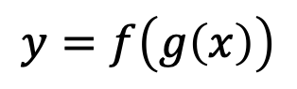
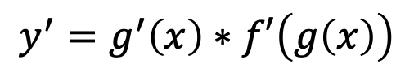
Chain rule and backprop
$$y=f\left(g\left(x\right)\right)$$
$$y^{′}=g^{′}\left(x\right)∗f′\left(g\left(x\right)\right)$$

Slide 47
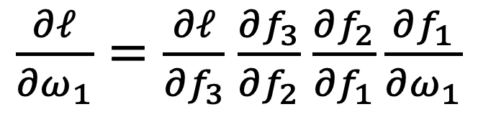
Chain rule and backprop
f_{ω}
𝑥
𝓁
f_{1,ω1}
f_{2,ω2}
f_{3,ω3}
$\frac{∂𝓁}{{∂ω}_{1}}=\frac{∂𝓁}{{∂f}_{3}}$ $\frac{∂f_{3}}{{∂f}_{2}}$ $\frac{∂f_{2}}{{∂f}_{1}}\frac{∂f_{1}}{{∂ω}_{1}}$

Slide 48
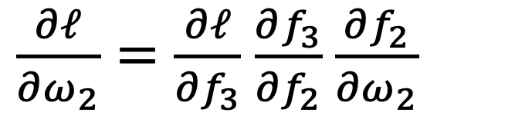
Chain rule and backprop
f_{ω}
𝑥
𝓁
f_{1,ω1}
f_{2,ω2}
f_{3,ω3}
$\frac{∂𝓁}{{∂ω}_{1}}=\frac{∂𝓁}{{∂f}_{3}}$ $\frac{∂f_{3}}{{∂f}_{2}}$ $\frac{∂f_{2}}{{∂f}_{1}}\frac{∂f_{1}}{{∂ω}_{1}}$
$\frac{∂𝓁}{{∂ω}_{2}}=\frac{∂𝓁}{{∂f}_{3}}$ $\frac{∂f_{3}}{{∂f}_{2}}$ $\frac{∂f_{2}}{{∂ω}_{2}}$

Slide 49
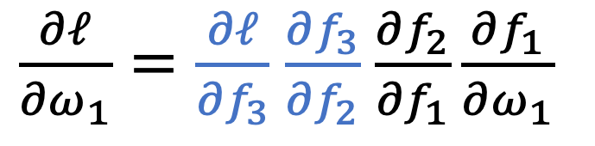
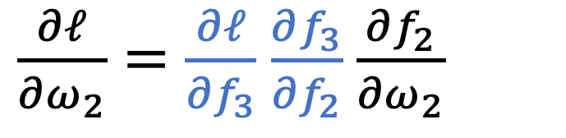
Chain rule and backprop
f_{ω}
𝑥
𝓁
f_{1,ω1}
f_{2,ω2}
f_{3,ω3}
$\frac{∂𝓁}{{∂ω}_{1}}=\frac{∂𝓁}{{∂f}_{3}}$ $\frac{∂f_{3}}{{∂f}_{2}}$ $\frac{∂f_{2}}{{∂f}_{1}}\frac{∂f_{1}}{{∂ω}_{1}}$
$\frac{∂𝓁}{{∂ω}_{2}}=\frac{∂𝓁}{{∂f}_{3}}$ $\frac{∂f_{3}}{{∂f}_{2}}$ $\frac{∂f_{2}}{{∂ω}_{2}}$

Slide 50
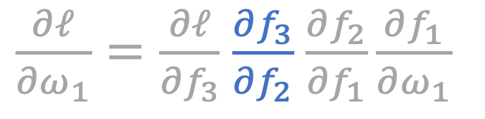
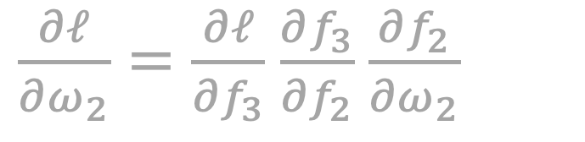
Chain rule and backprop
f_{ω}
All subfunctions of a neural net are easy to derive
𝑥
𝓁
f_{1,ω1}
f_{2,ω2}
f_{3,ω3}
$\frac{∂𝓁}{{∂ω}_{1}}=\frac{∂𝓁}{{∂f}_{3}}$ $\frac{∂f_{3}}{{∂f}_{2}}$ $\frac{∂f_{2}}{{∂f}_{1}}\frac{∂f_{1}}{{∂ω}_{1}}$
$\frac{∂𝓁}{{∂ω}_{2}}=\frac{∂𝓁}{{∂f}_{3}}$ $\frac{∂f_{3}}{{∂f}_{2}}$ $\frac{∂f_{2}}{{∂ω}_{2}}$

Slide 51
The lol() function
f
a
*
e
*
L
+
d
b
c

Slide 52
The lol() function
ω₂
𝑥₁
*
e
*
L
+
d
𝑥₂
ω₁

Slide 53




The lol() function
$$\frac{∂L}{∂ω_{2}}$$
$$\frac{∂L}{∂L}=1$$
ω₂
𝑥₁
*
e
*
L
+
d
𝑥₂
ω₁
$$\frac{∂L}{∂x_{2}}$$
$$\frac{∂L}{∂ω_{1}}$$

Slide 54
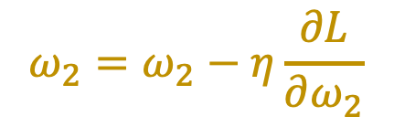
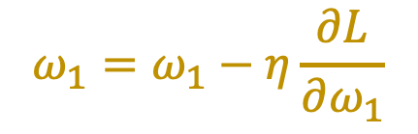
Gradient descent for the lol() function
$$ω_{1}=ω_{1}−η\frac{∂L}{∂ω_{1}}$$
$$ω_{2}=ω_{2}−η\frac{∂L}{∂ω_{2}}$$

Slide 55




The lol() function
$$\frac{∂L}{∂ω_{2}}$$
A Value object with a “grad” parameter
$$\frac{∂L}{∂L}=1$$
ω₂
𝑥₁
*
e
*
L
+
d
𝑥₂
ω₁
$$\frac{∂L}{∂x_{2}}$$
$$\frac{∂L}{∂ω_{1}}$$

Slide 56
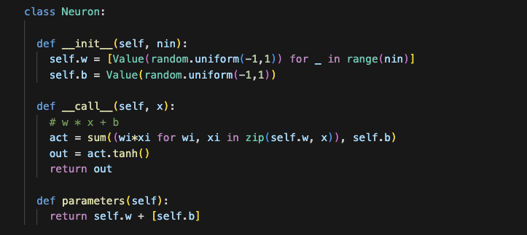
ω₂
𝑥₁
*
e
*
L
+
d
𝑥₂
ω₁

Slide 57
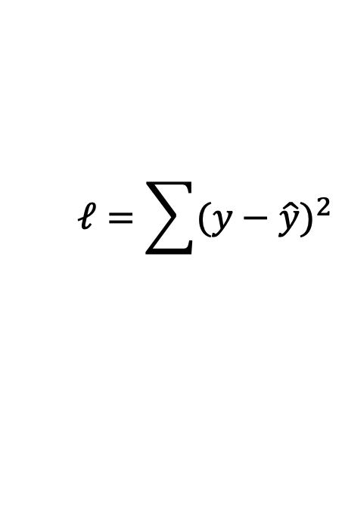
Mean square error loss
$$𝓁=\sum{{(y−\hat{y})}^{2}}$$
n = MLP(3, [4, 4, 1])
ypred = [n(x) for x in xs]
loss = sum([(a-b)**2 for (a,b) in zip(ypred, ys)])

Slide 58
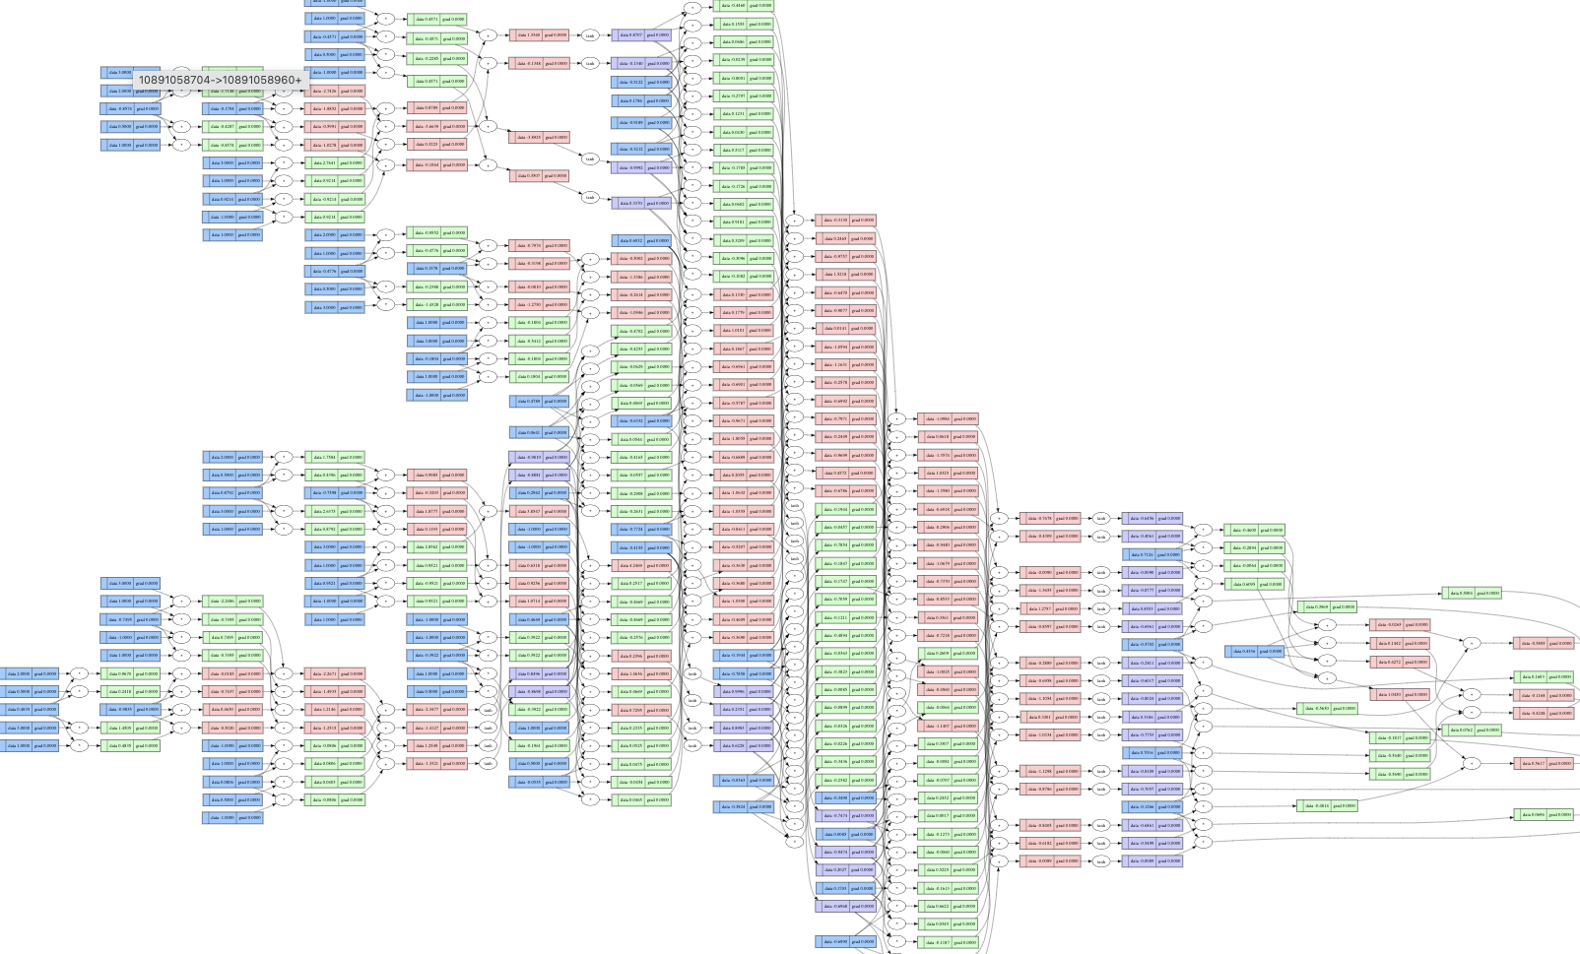
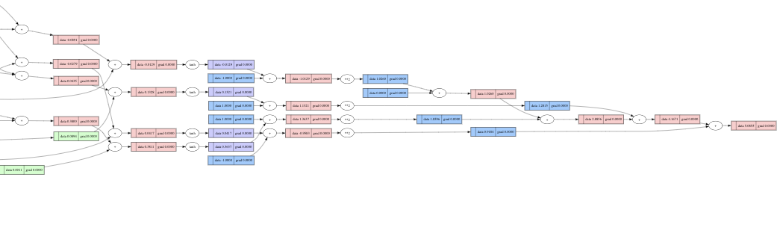
Compute graphs become huge very quickly
This is a 3-layer MLP with 41 parameters!

Slide 59
Why += in the gradient update?
f
a
*
e
*
L
+
d
b
c

Slide 60

Why += in the gradient update?
f
a
*
e
*
L
+
d
b
$$\frac{∂L}{∂c}$$
c
+
h
s

Slide 61
But then you need to zero your gradient at each iteration!
ω = ω₀
Repeat:
Compute 𝓁(𝑥)
Reset ∇𝓁_{ω}
Compute ∇ 𝓁_{ω}
ω = ω - η * ∇ 𝓁_{ω}

Slide 62
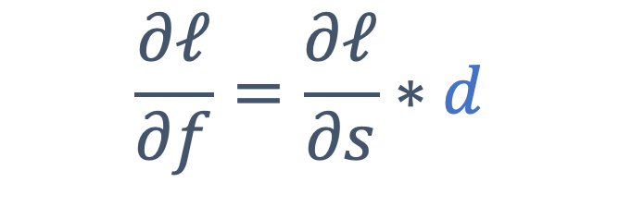
The forward pass is critical to update the values in the network
f
a
*
e
*
s
+
d
b
c
$$\frac{∂𝓁}{∂f}=\frac{∂𝓁}{∂s}∗d$$

Slide 63
Stochastic gradient descent
Iterate over batches of samples instead of the whole dataset at once
Scales to large datasets (that don’t fit in memory)
Adds randomness to the process

Slide 64
Now you should be able to finish TP1!

Slide 65
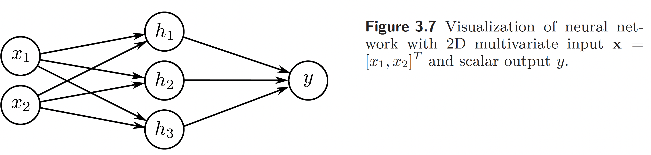
Source: Understanding Deep Learning, S. Prince, 2023
This work is subject to a Creative Commons CC-BY-NC-ND license. (C) MIT Press.

Slide 66
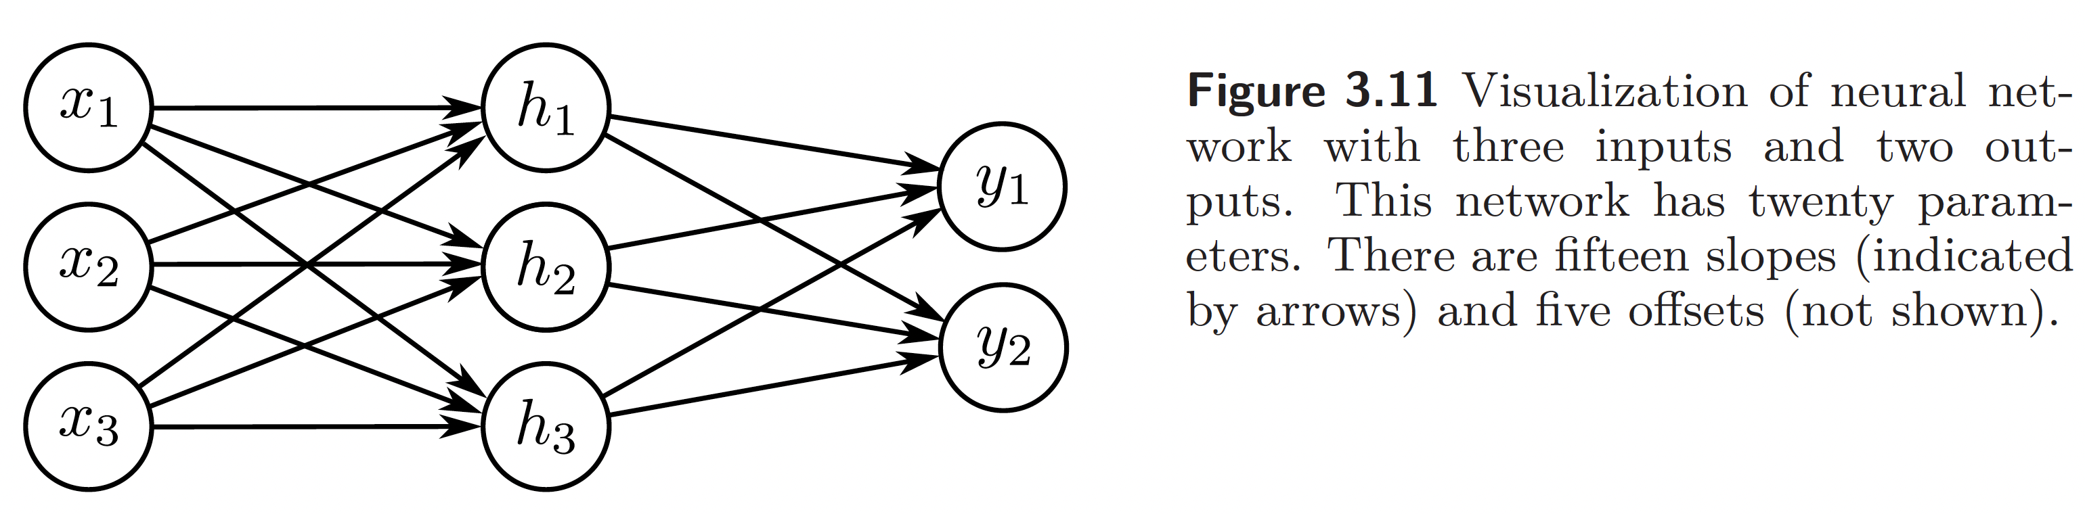
Source: Understanding Deep Learning, S. Prince, 2023
This work is subject to a Creative Commons CC-BY-NC-ND license. (C) MIT Press.

Slide 67
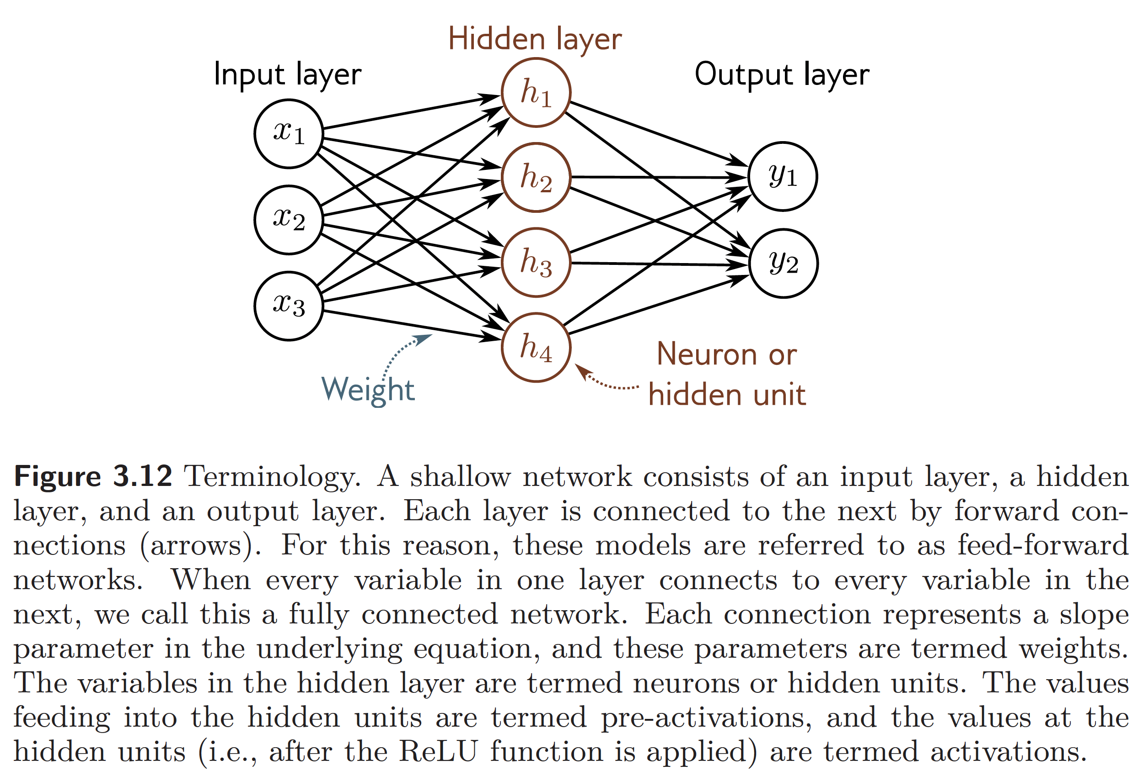
Source: Understanding Deep Learning, S. Prince, 2023
This work is subject to a Creative Commons CC-BY-NC-ND license. (C) MIT Press.

Slide 68
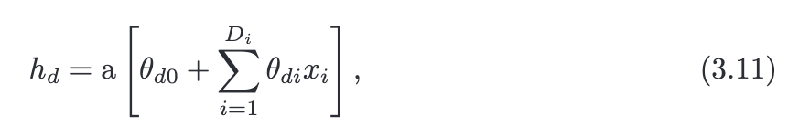
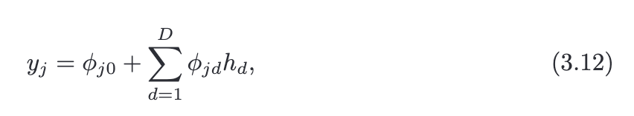
Source: Understanding Deep Learning, S. Prince, 2023
This work is subject to a Creative Commons CC-BY-NC-ND license. (C) MIT Press.

Slide 69
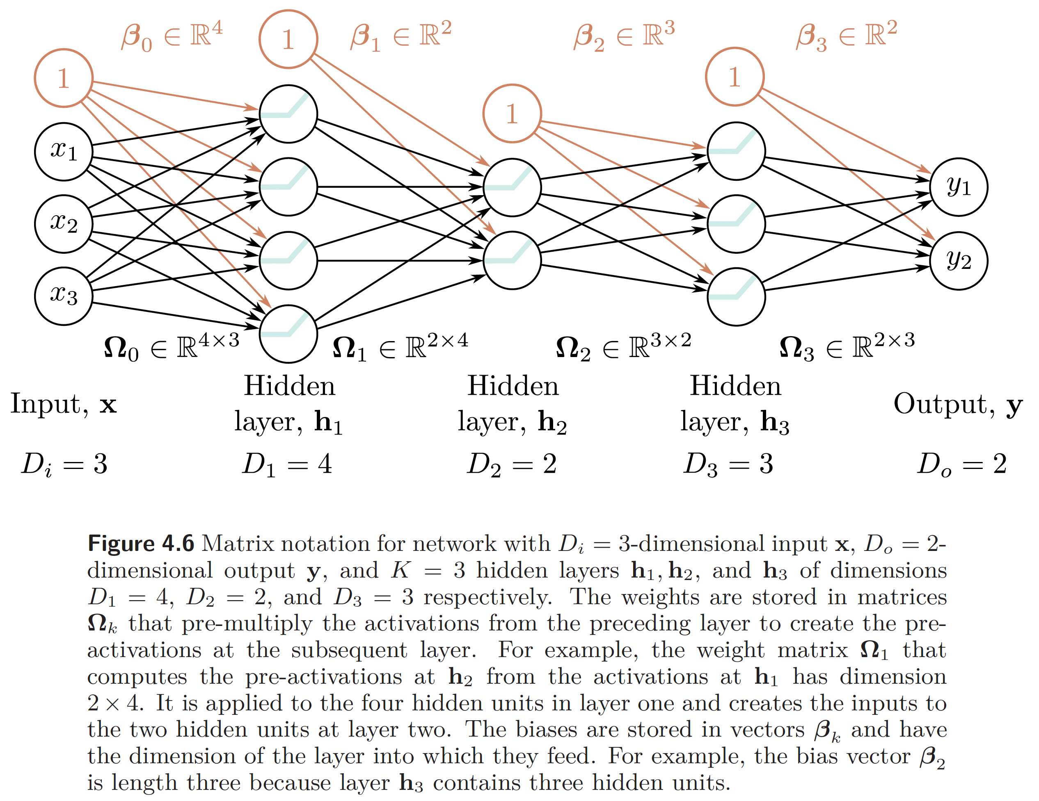
Source: Understanding Deep Learning, S. Prince, 2023
This work is subject to a Creative Commons CC-BY-NC-ND license. (C) MIT Press.

Slide 70
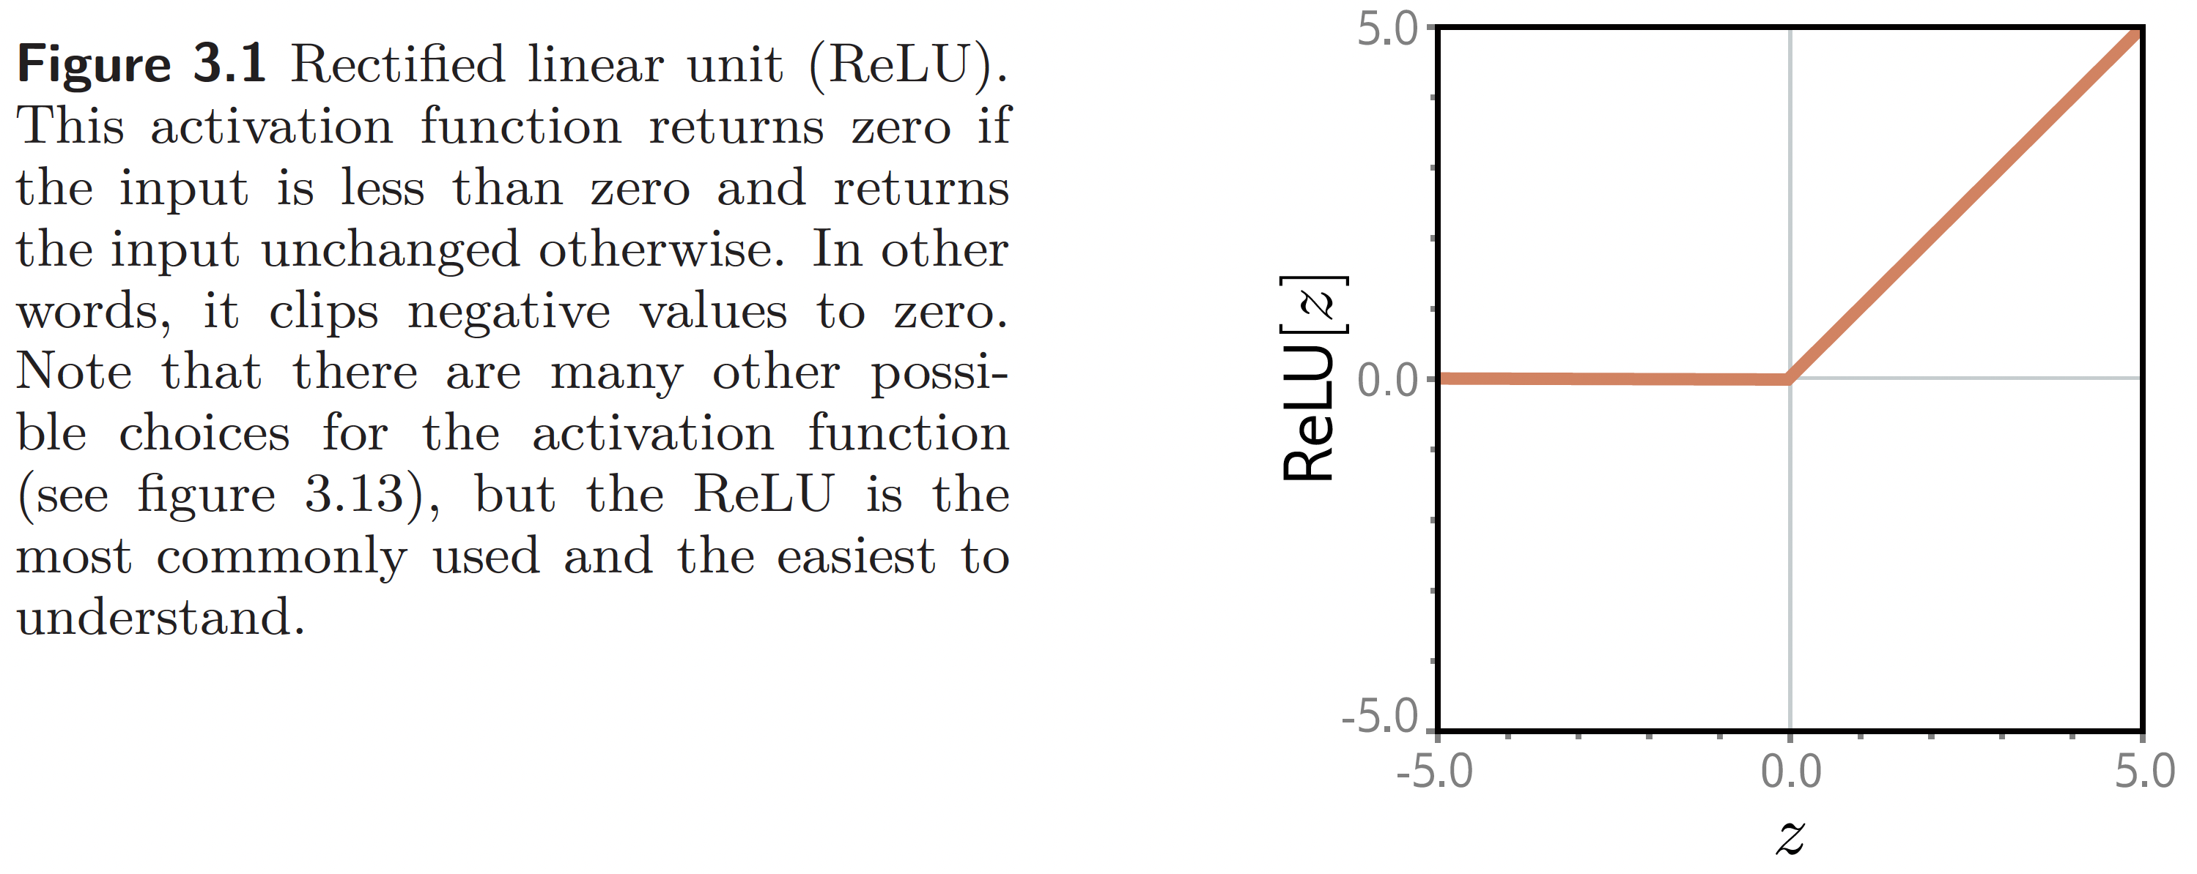
Source: Understanding Deep Learning, S. Prince, 2023
This work is subject to a Creative Commons CC-BY-NC-ND license. (C) MIT Press.

Slide 71
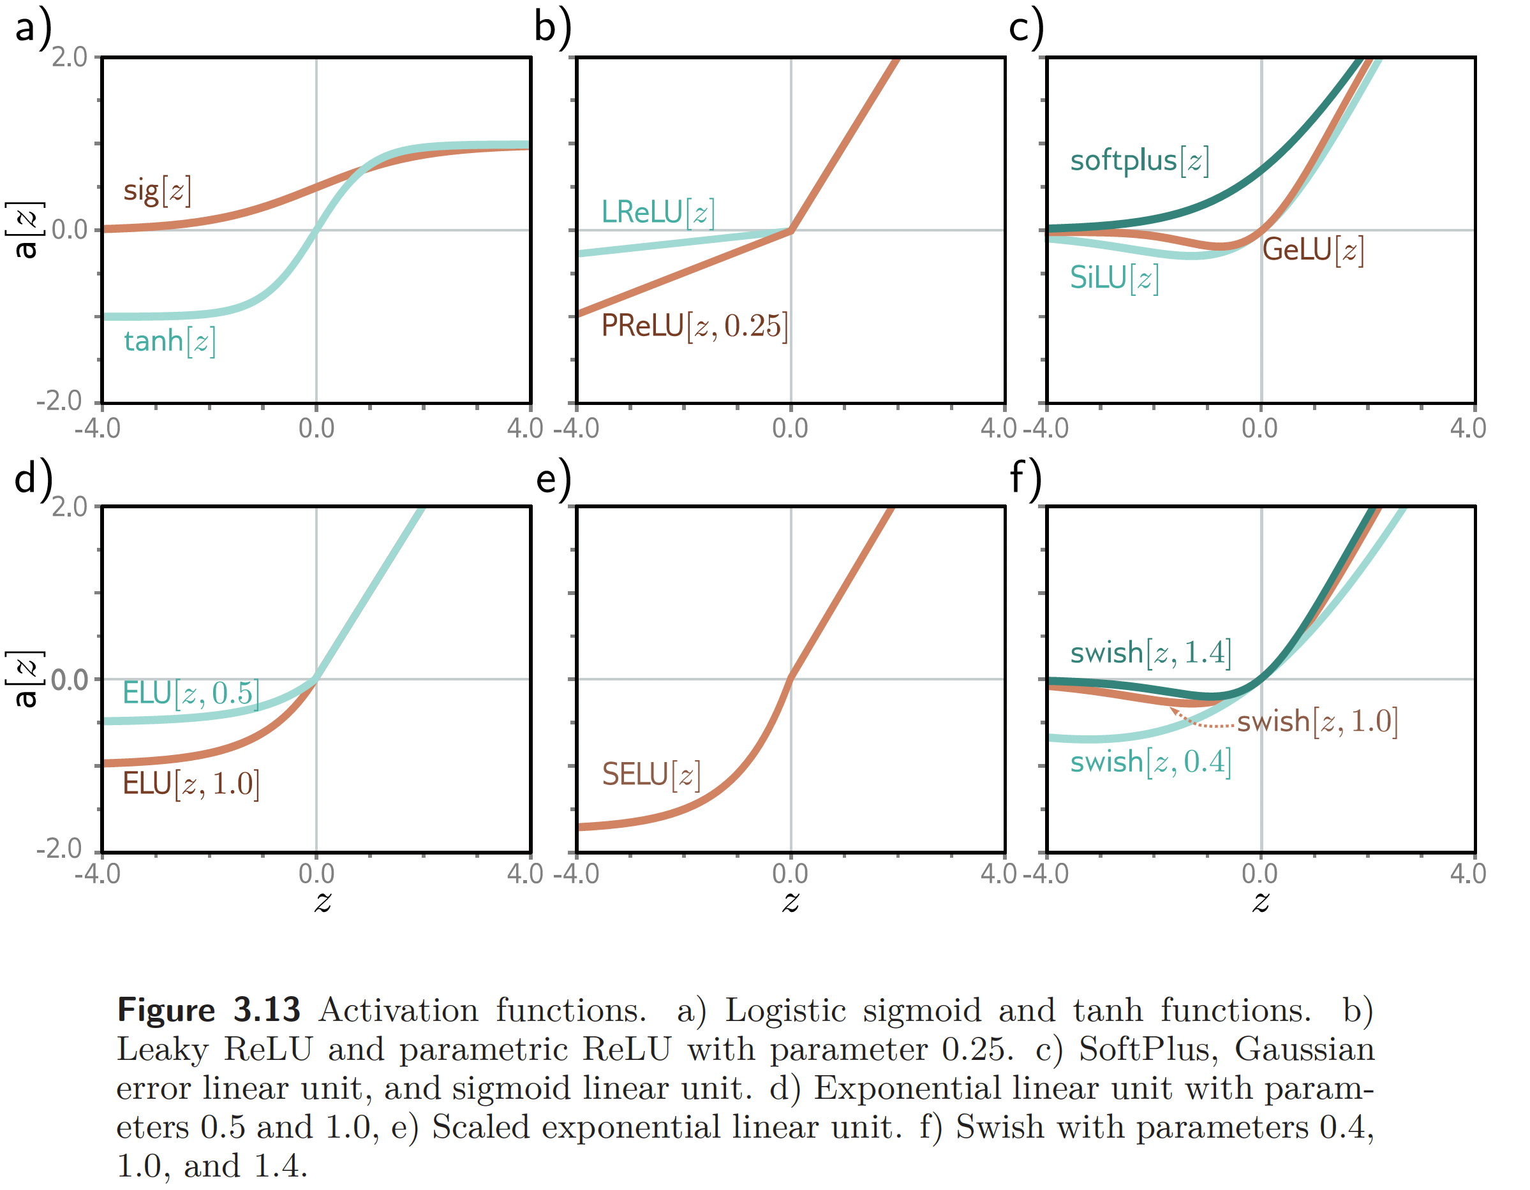
Source: Understanding Deep Learning, S. Prince, 2023
This work is subject to a Creative Commons CC-BY-NC-ND license. (C) MIT Press.

Slide 72
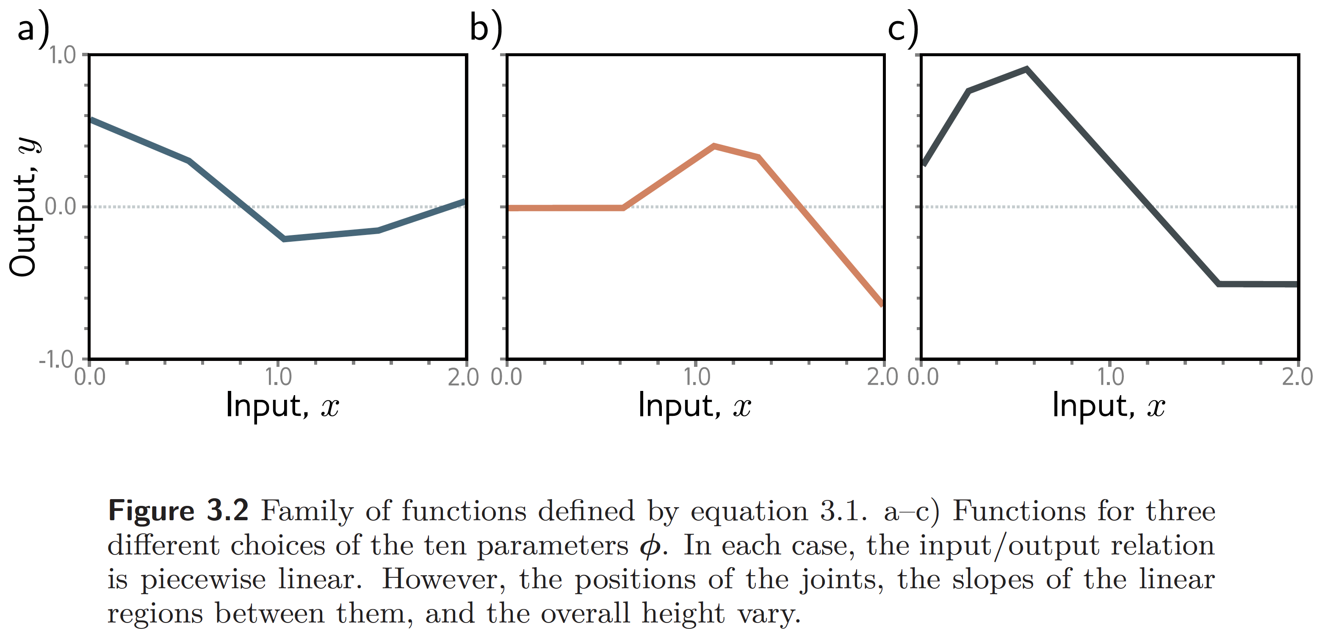
Source: Understanding Deep Learning, S. Prince, 2023
This work is subject to a Creative Commons CC-BY-NC-ND license. (C) MIT Press.

Slide 73
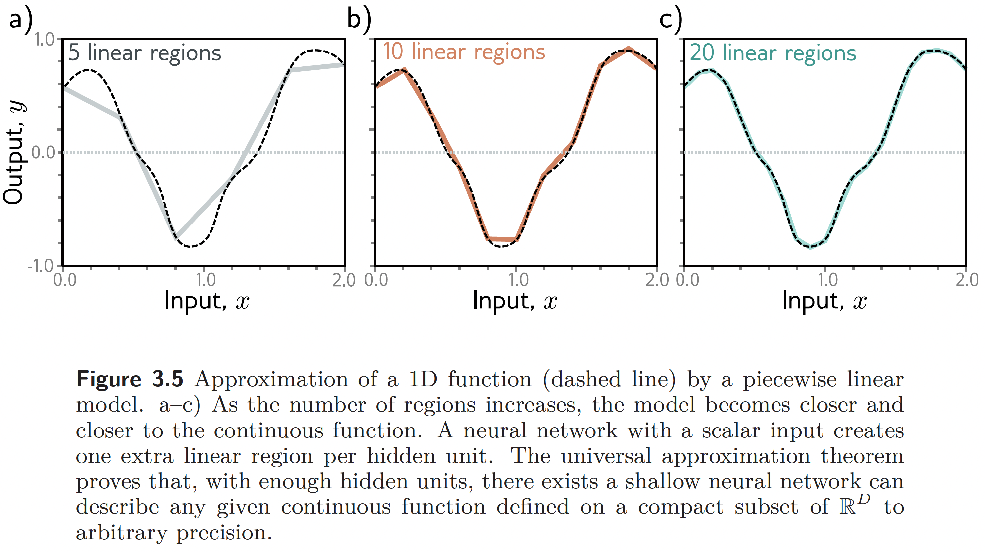
Source: Understanding Deep Learning, S. Prince, 2023
This work is subject to a Creative Commons CC-BY-NC-ND license. (C) MIT Press.

Slide 74
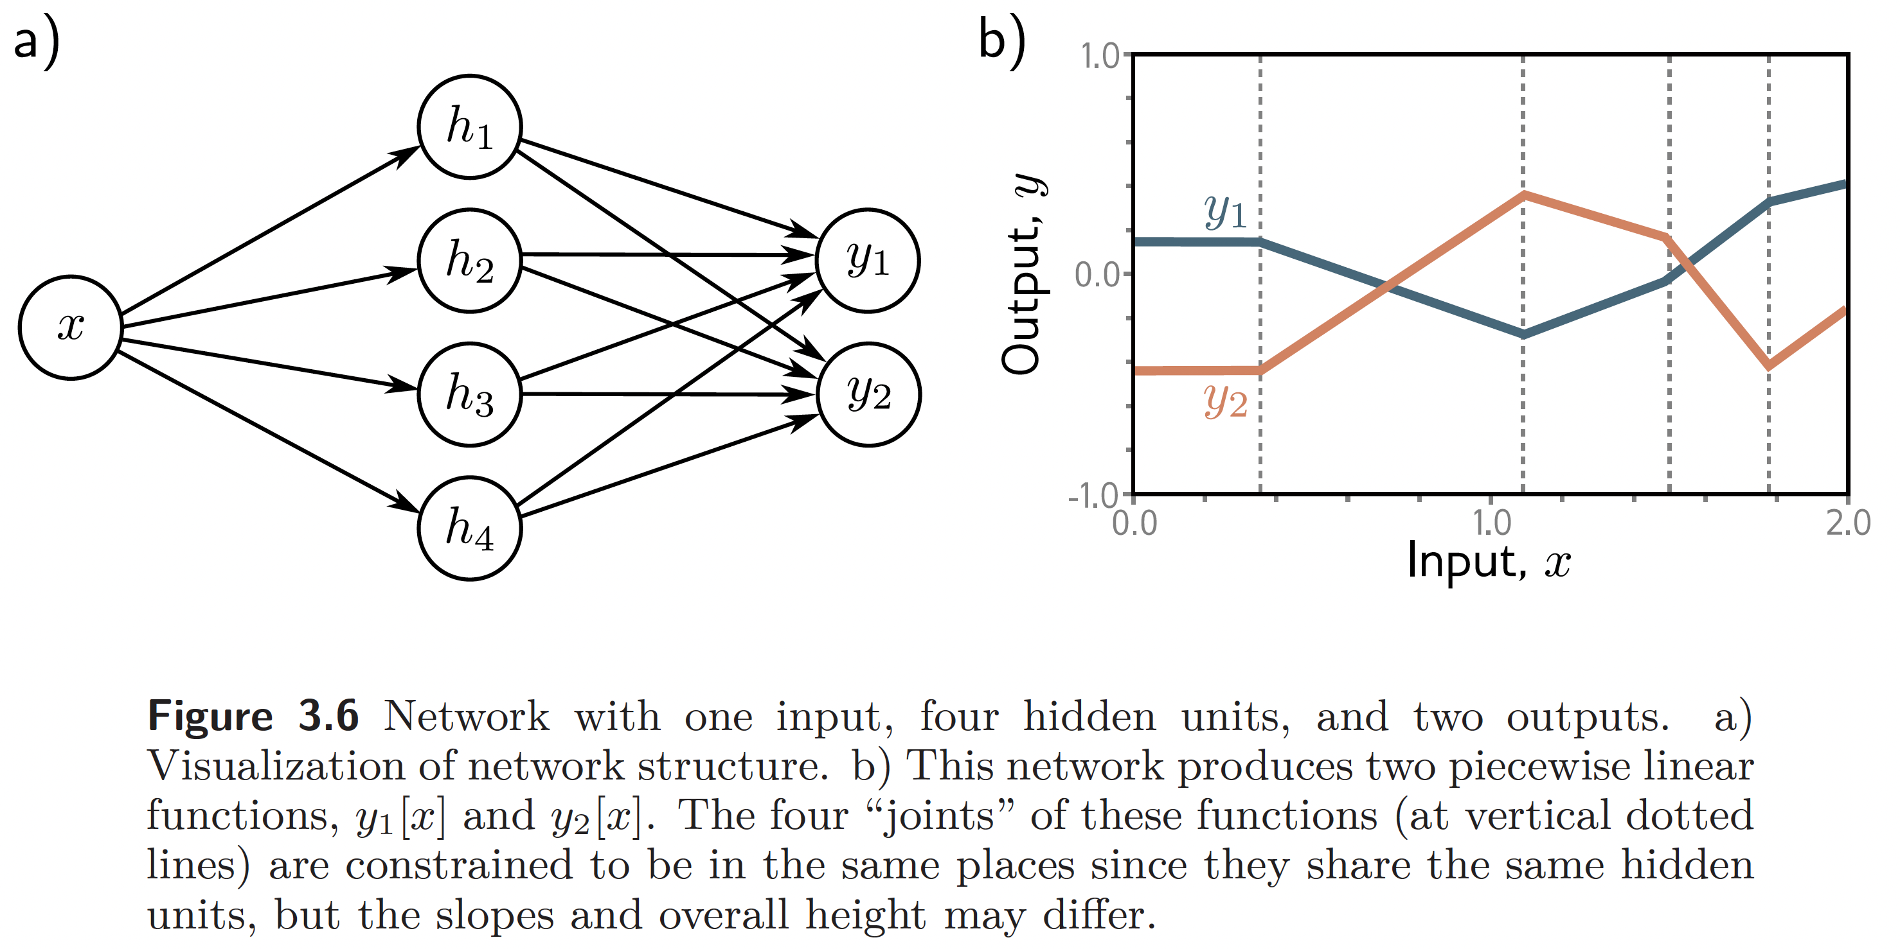
Source: Understanding Deep Learning, S. Prince, 2023
This work is subject to a Creative Commons CC-BY-NC-ND license. (C) MIT Press.

Slide 75
Universal approximation theorem
For any continuous function, there exists a shallow network that can approximate this function to any specified precision.

Slide 76
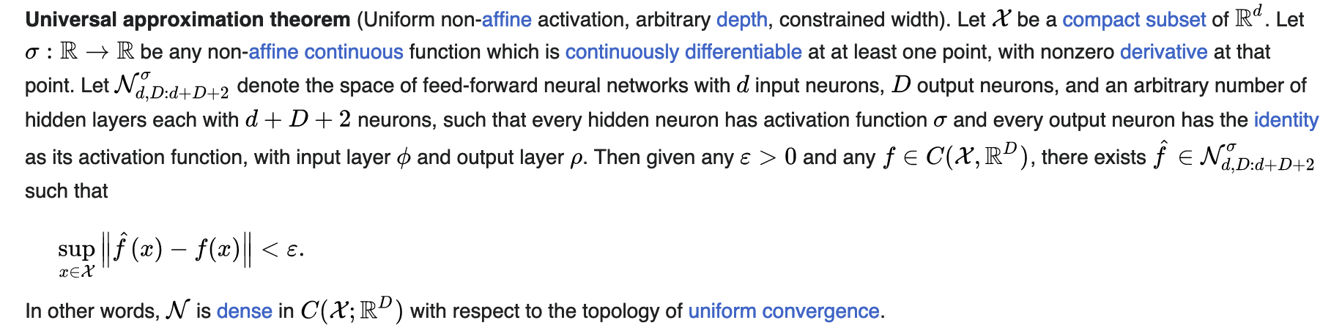
Universal approximation theorem

Slide 77
No free-lunch theorem
Every learning algorithm is as good as any other when averaged over all sets of problems.
You can’t just learn « purely from data » without bias.
Wolpert, D. H.; Macready, W. G. (1997). "No Free Lunch Theorems for Optimization". IEEE Transactions on Evolutionary Computation. 1: 67–82.

Slide 78
Why build deep networks if shallow networks are universal appromixators already?

Slide 79
Reason #1: More linear regions per parameter
D: number of units / layer
K: number of layers
3D + 1 + (K-1)D(D+1) regions

Slide 80
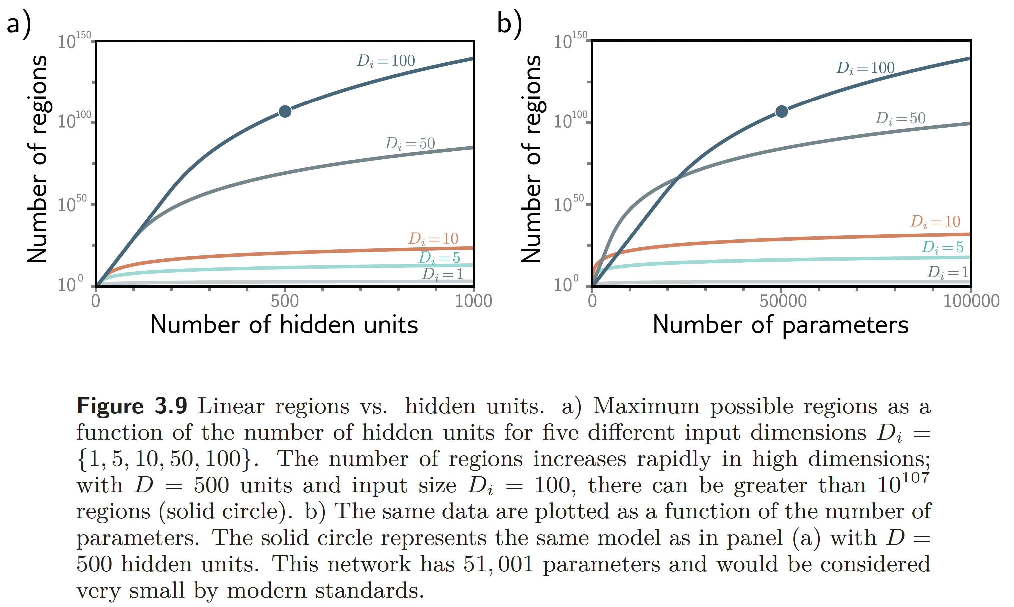
Source: Understanding Deep Learning, S. Prince, 2023
This work is subject to a Creative Commons CC-BY-NC-ND license. (C) MIT Press.

Slide 81
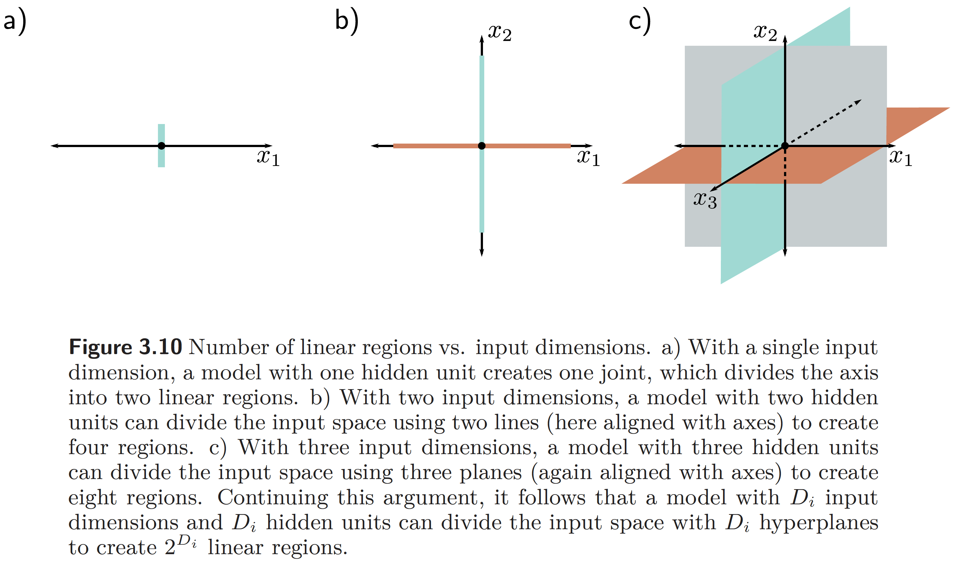
Source: Understanding Deep Learning, S. Prince, 2023
This work is subject to a Creative Commons CC-BY-NC-ND license. (C) MIT Press.

Slide 82
Reason #2: large, structured inputs
Deep networks allow us to bake the structure of the data into the structure of the network.
e.g. images and convnets

Slide 83
Reason #3: depth efficiency?
Try fitting the x^2 function with an MLP.

Slide 84
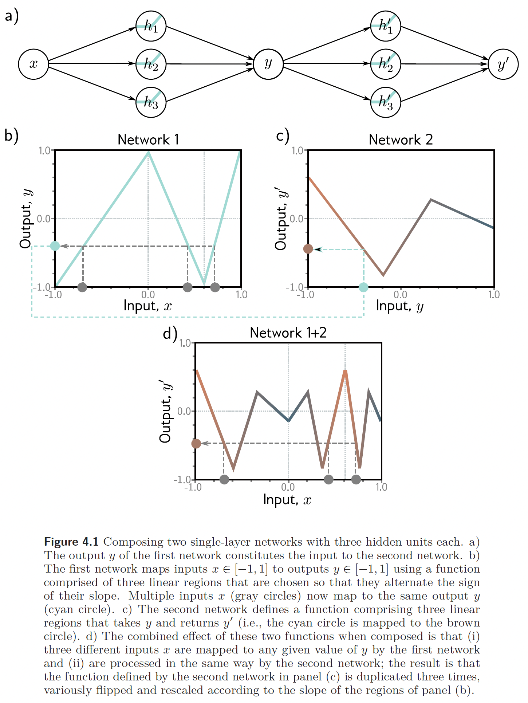
Source: Understanding Deep Learning, S. Prince, 2023
This work is subject to a Creative Commons CC-BY-NC-ND license. (C) MIT Press.

Slide 85
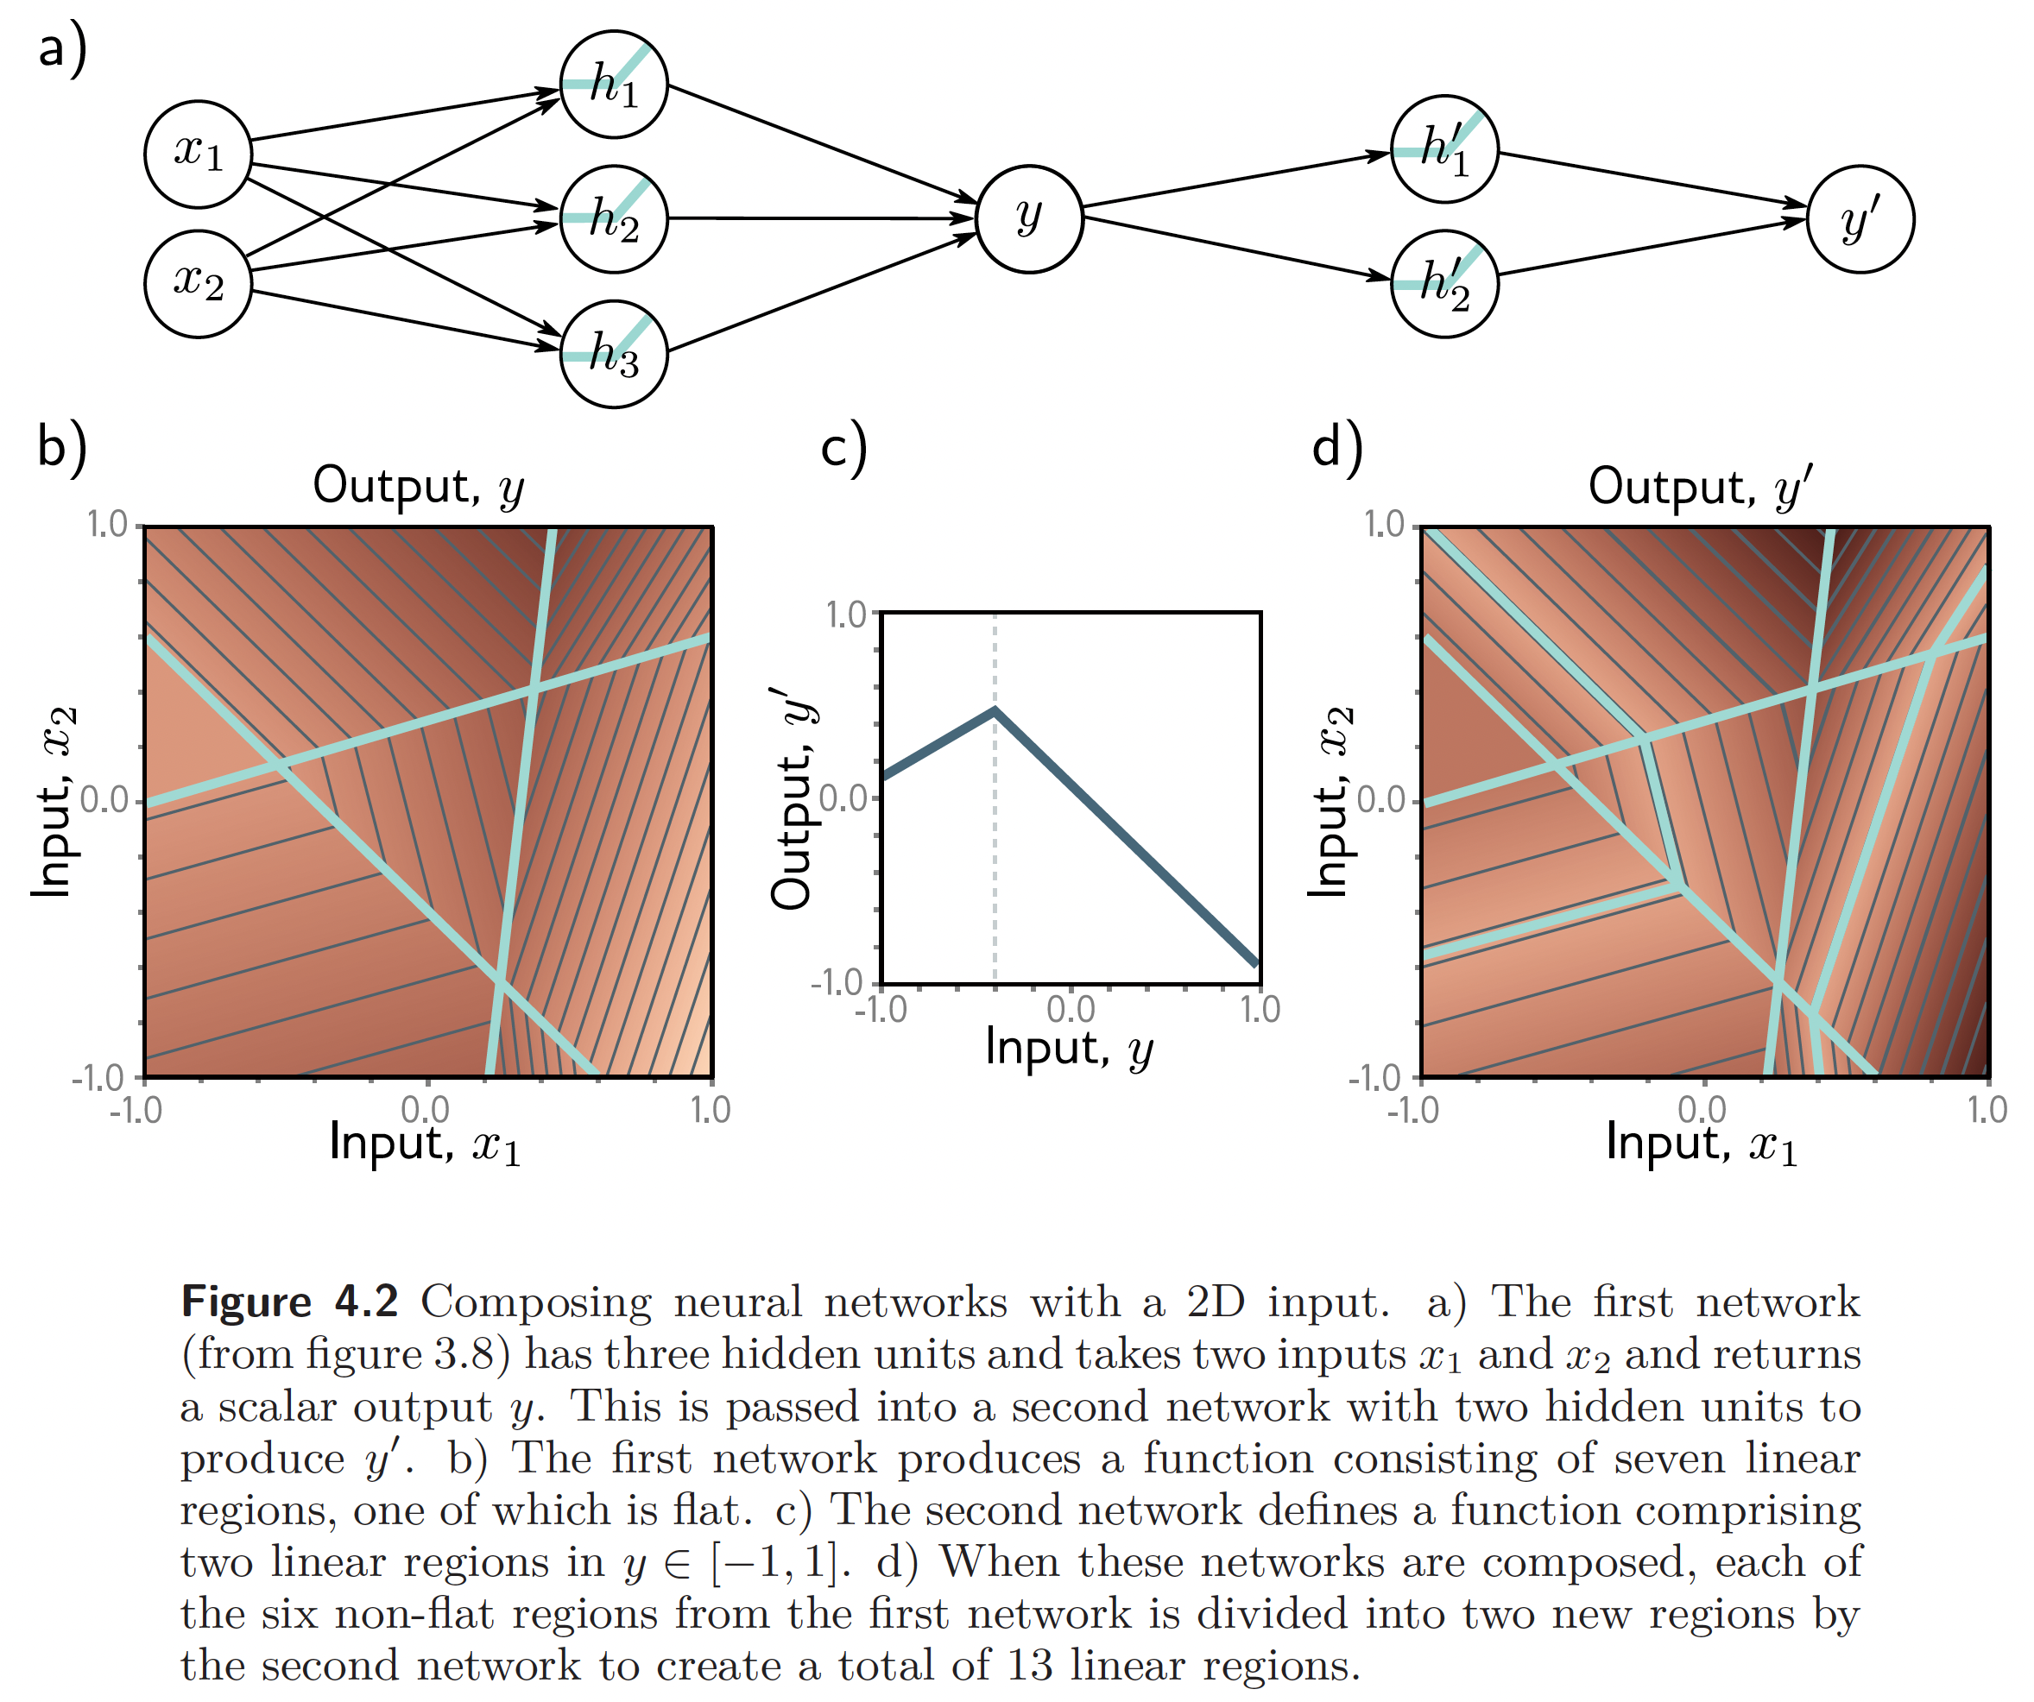
Source: Understanding Deep Learning, S. Prince, 2023
This work is subject to a Creative Commons CC-BY-NC-ND license. (C) MIT Press.

Slide 86

Source: Understanding Deep Learning, S. Prince, 2023
This work is subject to a Creative Commons CC-BY-NC-ND license. (C) MIT Press.

Slide 87
Training neural networks with backpropagation
Source: Deep Learning, Foundations and Concepts, Bishop, 2023

Slide 88

This work is subject to a Creative Commons CC-BY-NC-ND license. (C) MIT Press.

Slide 89

This work is subject to a Creative Commons CC-BY-NC-ND license. (C) MIT Press.

Slide 90

This work is subject to a Creative Commons CC-BY-NC-ND license. (C) MIT Press.

Slide 91

This work is subject to a Creative Commons CC-BY-NC-ND license. (C) MIT Press.

Slide 92

This work is subject to a Creative Commons CC-BY-NC-ND license. (C) MIT Press.

Slide 93

The chain rule for efficient backward computation
This work is subject to a Creative Commons CC-BY-NC-ND license. (C) MIT Press.

Slide 94

This work is subject to a Creative Commons CC-BY-NC-ND license. (C) MIT Press.

Slide 95
Practical 1
Source: Deep Learning, Foundations and Concepts, Bishop, 2023

Slide 96
Appendix
Source: Deep Learning, Foundations and Concepts, Bishop, 2023

Slide 97



Training neural networks with backpropagation
Error function
SSE example
Chain rule
Source: Deep Learning, Foundations and Concepts, Bishop, 2023

Slide 98

Sanity checking with finite differences
Source: Deep Learning, Foundations and Concepts, Bishop, 2023

Slide 99

Source: Deep Learning, Foundations and Concepts, Bishop, 2023

Slide 100
But there are other universal approximators!
What about Gaussian processes?

Slide 101
GP advantages / DNN disadvantages:
Generally require less data than DNNs
Only need to optimize a small number of (hyper)parameters.
Are robust to phenomena such as exploding and vanishing gradients (since, unless you are using Deep GPs, there is no “layer structure” within this framework).

Slide 102
GP disadvantages / DNN advantages:
Runtime scales poorly with the number of samples. The runtime complexity is O(n³), where n is the number of samples. This is a result of having to perform matrix inversion (or pseudo-inversion) of large covariance matrices.
There is less automatic learning relative to neural networks, and more design considerations need to be made for the choice of kernel/covariance function, mean function, and hyperparameter prior distributions. These parameters can have a substantial effect on what the GP is able to learn.

Slide 103
In short: deep learning scales to larger datasets

